Slide 1

STANDARD PROPOSAL - 3

Slide 2
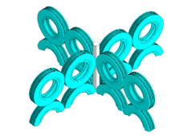
cross Climber
Activity - Climbing

Slide 3
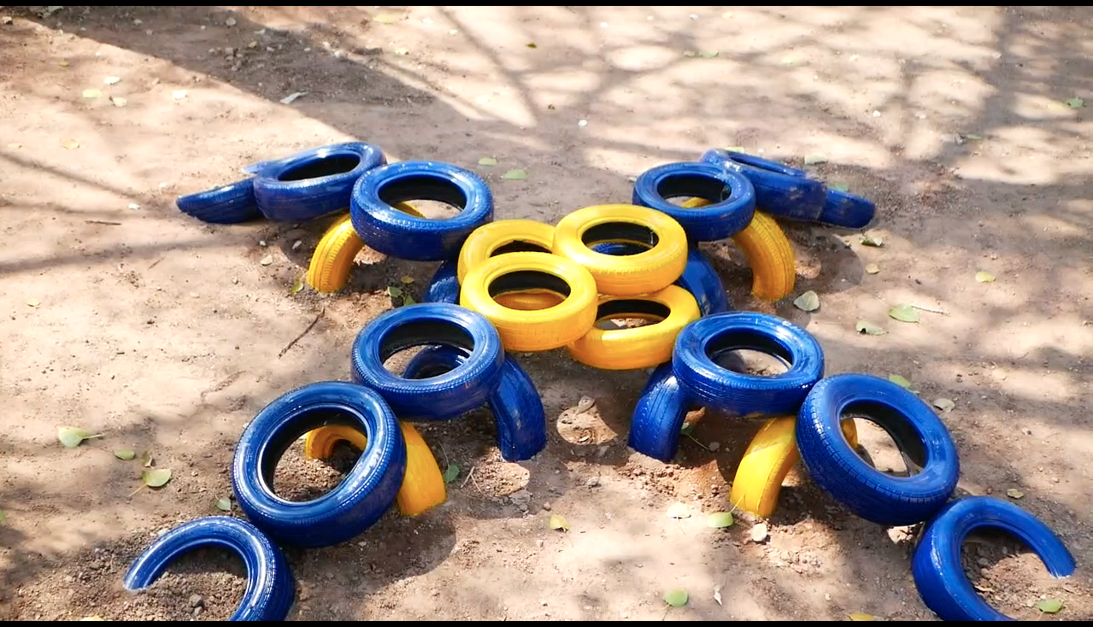
bridge wobble tyre
Activity - balance walk

Slide 4
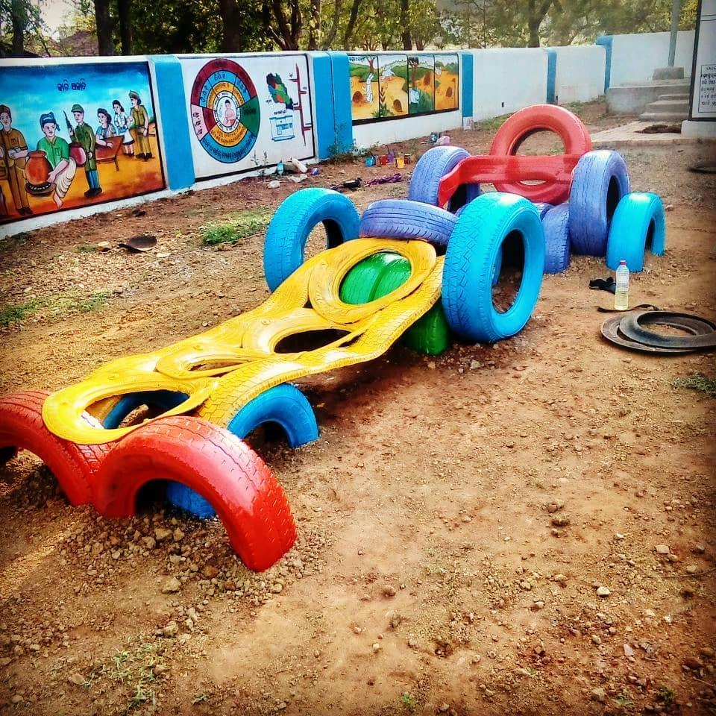
Car - on a drive!
Activity : Role play

Slide 5
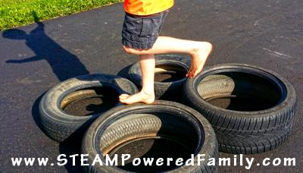
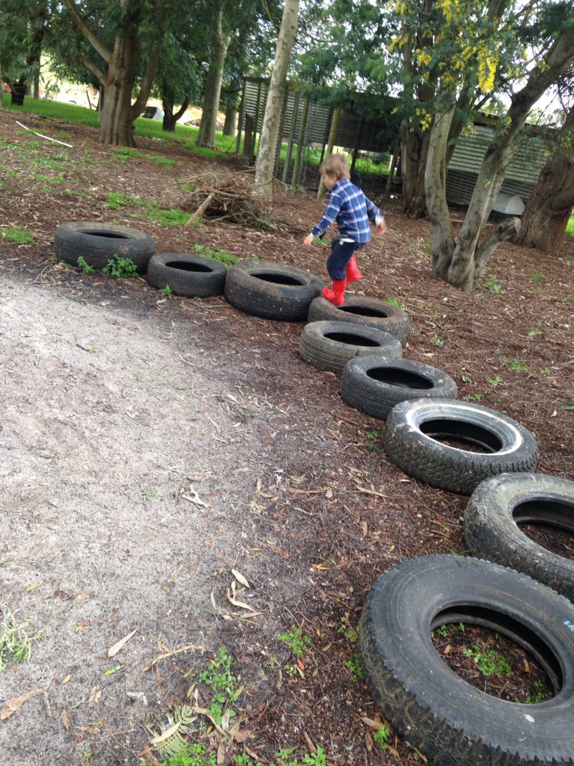
Assorted tyre hopping
Activity : Hopping

Slide 6
TYRE SWINGS
Swings are relaxing and a fun game for children and adults. This would explain to the children the idea of oscillatory motion. The metal bars especially the ones on the sides can be used to create fun puzzles for them to solve.
note : The following image explains the idea of the element and the following element, will be further detailed out to fit site context.

Slide 7
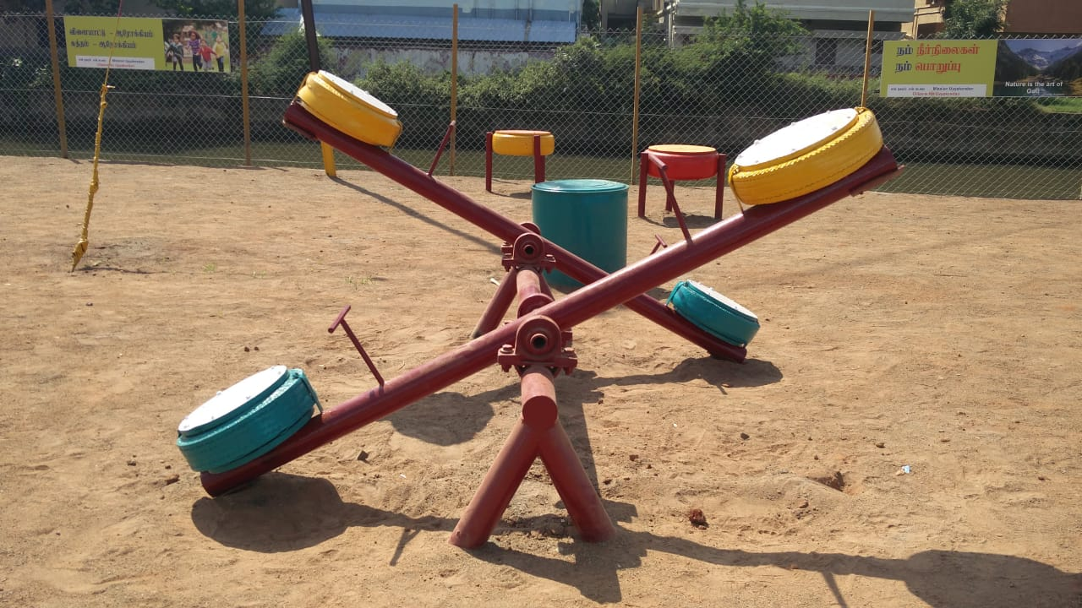
SEE SAW
A seesaw is a lever, which is found in most of children's parks. A couple of seesaws would explain some science and the idea of balance.
note : The following image explains the idea of the element and the following element, will be detailed out such that, there would be no settling corners for snakes.

